Slide 1
Red Black Tree
MD. Azman Ahmed
2020-1-60-217

Slide 2
What is Red Black tree?
Red-Black tree is a self-balancing binary search tree in which each node contains an extra bit for denoting the color of the node, either red or black.
Properties of Red Black tree:
It is a self balancing BST
Every Node is either red or black
The root of the tree is always black tree
Every leaf which is nil is black
If a Node is Red then its children can not be red
Every path from a node to any of its descendent nil node has the same number of Black nodes.

Slide 3

Red Black tree vs AVL tree
AVL trees provide faster lookups than Red Black Trees because they are more strictly balanced.
Red Black Trees provide faster insertion and removal operations than AVL trees as fewer rotations are done due to relatively relaxed balancing.
AVL trees store balance factors or heights with each node, thus requires storage for an integer per node whereas Red Black Tree requires only 1 bit of information per node.
Red Black Trees are used in most of the language libraries like map, multimap, multi set in C++ whereas AVL trees are used in databases where faster retrievals are required.
Because of the 4th rule The longest path from the root is no longer than the shortest path from the root

Slide 4
Operations in Red black tree;
Insertion
Deletion
Searching
Traversal in Red Black Tree:
Pre Order
In Order
Post Order

Slide 5

Insertion:
Initially a new node is inserted as a red node.
Why newly inserted nodes are always red in a red-black tree?
This is because inserting a red node does not violate the depth property of a red-black tree.
If you attach a red node to a red node, then the rule is violated but it is easier to fix this problem than the problem introduced by violating the depth property.
If the parent of newly inserted node is also Red then the tree becomes unbalanced.

Slide 6
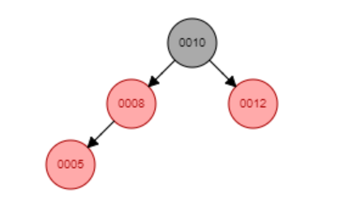
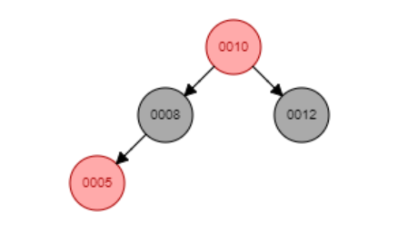
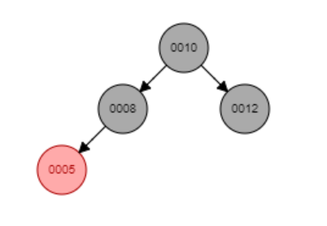
Fixing the unbalanced tree after insertion:
Case 1:
If the uncle node of newly inserted node is also red then set both the parent and uncle node as black and set the grandparent(gp) of the new node as red.
Now continue the same process for gp until the root node is found.

Slide 7
Case 2:
There is no uncle node of new node,
Case A: if New node is the left node of parent node and parent node is the left node of grand parent then we will right rotate the gp and mark gp as red and parent as black.
Case B: if the new node is the right node of parent node and parent node is the left node of gp then we will left rotate the parent node and then right rotate the gp node. After that parent node and gp node is colored as red and new node is colored as Black
Case C: if New node is the right node of parent node and parent node is the right node of grand parent then we will left rotate the gp and mark gp as red and parent as black.
Case D: if the new node is the left node of parent node and parent node is the right node of gp then we will right rotate the parent node and then left rotate the gp node. After that parent node and gp node is colored as red and new node is colored as Black.

Slide 8
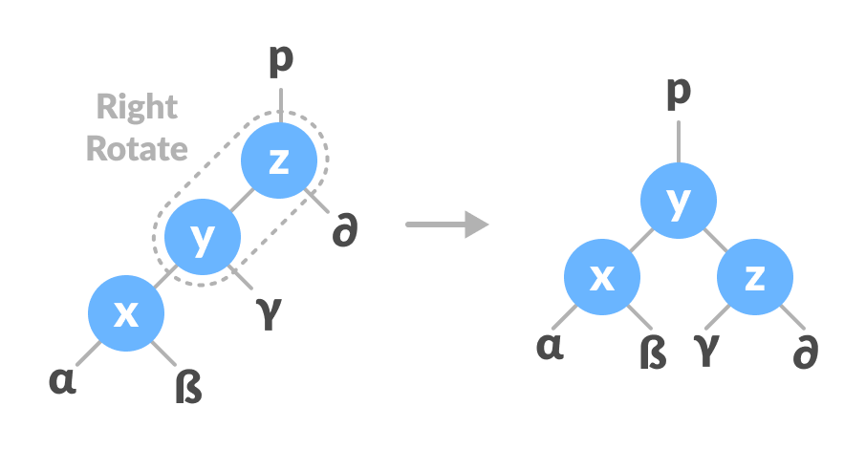
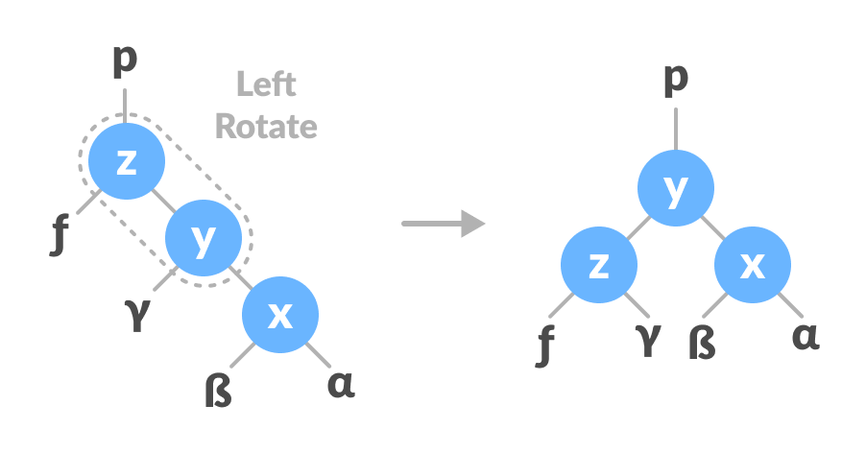
Rotation in Subtrees of RBT:
Figure: Right Rotation
Figure: Left Rotation

Slide 9
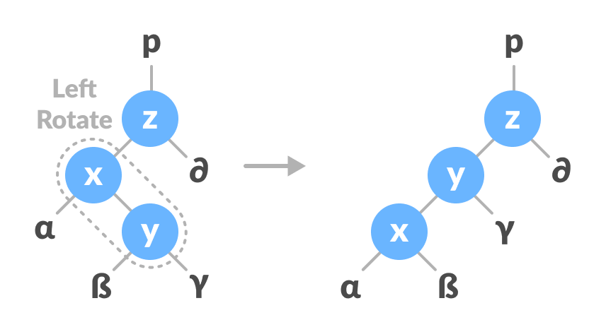
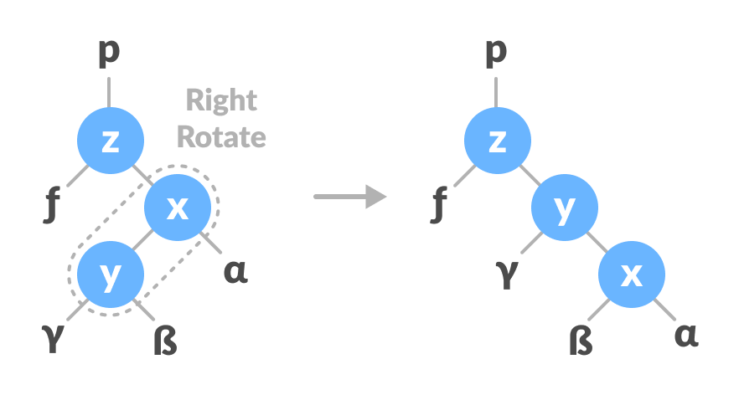
Figure: Left – Right Rotation
Figure: Right – Left Rotation

Slide 10
Algorithm to delete a node:
Save the color of the node that will be deleted
If the left child of the node that will be deleted is null, then replace deleted node with the right child.
If the right child of the node that will be deleted is null, then replace deleted node with the left child.
Else
Assign the minimum of right subtree of note To Be Deleted into y.
Save the color of y in originalColor.
Assign the rightChild of y into x.
If y is a child of node To BeDeleted, then set the parent of x as y.
Else, transplant y with rightChild of y.
Transplant node To BeDeleted with y.
Set the color of y with originalColor.
If the originalColor is BLACK, call DeleteFix(x).

Slide 11
Algorithm of DeleteFix(X):
It reaches the root node.
If x points to a red-black node. In this case, x is colored black.
Suitable rotations and recoloring are performed.
The following algorithm retains the properties of a red-black tree.
Do the following until the x is not the root of the tree and the color of x is BLACK
If x is the left child of its parent then,
Assign w to the sibling of x.
If the right child of parent of x is RED, Case-I:
Set the color of the right child of the parent of x as BLACK.
Set the color of the parent of x as RED.
Left-Rotate the parent of x.
Assign the rightChild of the parent of x to w.
If the color of both the right and the leftChild of w is BLACK, Case-II:
Set the color of w as RED
Assign the parent of x to x.

Slide 12
3. Else if the color of the rightChild of w is BLACK Case-III:
Set the color of the leftChild of w as BLACK
Set the color of w as RED
Right-Rotate w.
Assign the rightChild of the parent of x to w.
4. If any of the above cases do not occur, then do the following. Case-IV:
Set the color of w as the color of the parent of x.
Set the color of the parent of x as BLACK.
Set the color of the right child of w as BLACK.
Left-Rotate the parent of x.
Set x as the root of the tree.
Else the same as above with right changed to left and vice versa.
Set the color of x as BLACK.

Slide 13
Thank You

